Slide 1
THE MUSIC PLAYER SYSTEM
Presented by-
17R01A0535
17R01A0539
17R01A0545
17R01A0549

Slide 2
Purpose of a music player
As streaming is increasingly being adopted by users, online media players have become essential for consuming media on the internet. Music players allow one to enjoy music in any browser and supports a lot of the features of an offline music player.We will be creating a music player with a clean user interface that can be used to play music in the browser. We will also implement features like seeking and volume control.

Slide 3
Methodologies
There are about four different models involved in this project they are
1.Play Music
2.Pause Music
3.Change and alter Song
4.Volume control

Slide 4
Play music
All the tracks that have to be played are defined in the tracklist as objects. These objects contain properties like the name, artist, image and path to the track. Each of the tracks can then be accessed using its track index
Loading the track:
The audio element is assigned a new source using its src property. It may be given any path from the filesystem or a URL. The load() method is then used on the audio element to get the track ready.A function playTrack() handles the playing of the currently loaded track. The play() method of the HTMLMediaElement API is used for this function. The icon of the button also changes to the pause icon. This is done by using one of the icons from the FontAwesome library and inserting it using innerHTML.

Slide 5
Pause music
A function pauseTrack() handles the playing of the currently loaded track. The pause() method of the HTMLMediaElement API is used for this function. The icon of the button also changes back to the play icon. This is done by using one of the icons from the FontAwesome library and inserting it using innerHTML.These two functions are invoked depending on whether the track is currently playing or not. The playpause() function handles the actual play/pause control of the track.

Slide 6
Change and alter song
A function prevTrack() handles the loading of the previous track and moving the index backward. The index is reset to the last track when the index reaches the first track. The loadTrack() method defined above is used for loading the new track. A function nextTrack() handles the loading of the next track and moving the index forward. The index is reset to the first track when the index reaches the last track. The loadTrack() method defined above is used for loading the new track.

Slide 7
The seek slider
The seek slider shows the current playback position on a slider by updating it with the current time of the track. A new function is created seekUpdate() which handles the updating of the seek slider relative to the current time of the track. The seek slider position is calculated and set using the value property.

Slide 8
Volume controller
To increase and decrease the volume of the song being played we use volume slider which helps to control the volume.
The volume slider:
The volume slider is used to display an set the current volume of the track. A new function is created setVolume() which handles the setting of the volume slider whenever the user changes it.

Slide 9
Physical design
HARDWARE REQUIREMENTS
System : PentiumIV 2.4
Hard Disk : 40 GB.
RAM : 512 Mb.
SOFTWARE REQUIREMENTS:
HTML & CSS
JavaScript
OPERATING SYSTEMS SUPPORTED :
Windows 7,10,8
Android

Slide 10
Project Analysis
Existing System :
As streaming is increasingly being adopted by users, online media players have become essential for consuming media on the internet. Music players allow one to enjoy music in any browser and supports a lot of the features of an offline music player.Usually if we want to listen to some music , we need to download an app and then get the songs what we wanted.It works only in online and if we want to listen in offline we need to download the required songs.
Proposed System :
Creating a music player with a clean user interface that can be used to play music in the browser.We will also implement features like seeking and volume control.The songs are directly available in browser and we can listen to them easily. It does not require any app.

Slide 11
Implementation
We will be creating a music player with a clean user interface that can be used to play music in the browser. We will also implement features like seeking and volume control. HTML has several methods in the HTMLMediaElement interface that can be used to play audio files and control its playback without using any other library.

Slide 12
The HTML Layout
Details Portion
Buttons Portion
Sliders Portion

Slide 13
The CSS Styling
The flex layout is used to arrange the various elements of the player and align them to the middle of the page.
The track art image is given a fixed dimension and made rounded using the border-radius property.The two sliders have been modified from their default look by using the appearance property.
The height and background are changed to suit the color scheme. They are also given slight transparency that smoothly transitions to the full opacity using the transition property.
All the playback controls have their cursor property set so that it changes to a pointer whenever the mouse hovers over it.

Slide 14
JavaScript logic of the player
Using CSS we can style the different portions to make it more visually appealing
JavaScript logic of the player:
Step 1: Defining all the variables and accessing the HTML elementsThe required elements in the HTML layout that are to be dynamically changed are first selected using the querySelector() method. They are then assigned variable names so that they could be accessed and modified. Other variables that would be accessed throughout the program are also defined.

Slide 15
Step 2: Loading a new track from the tracklistAll the tracks that have to be played are defined in the tracklist as objects. These objects contain properties like the name, artist, image and path to the track. Each of the tracks can then be accessed using its track index.To load a track, a function loadTrack() is defined which handles the following things:
Reset all the values of the previous track
Loading the track
Updating the track art to be shown
Updating the track details to be shown
Adding event listeners to the track
Setting a random colored background

Slide 16
A function playTrack() handles the playing of the currently loaded track. The play() method of the HTMLMediaElement API is used for this function. The icon of the button also changes to the pause icon. This is done by using one of the icons from the FontAwesome library and inserting it using innerHTML.
A function pauseTrack() handles the playing of the currently loaded track. The pause() method of the HTMLMediaElement API is used for this function. The icon of the button also changes back to the play icon.
A function prevTrack() handles the loading of the previous track and moving the index backward.
The loadTrack() method defined above is used for loading the new track.

Slide 17
The seek slider:
The seek slider shows the current playback position on a slider by updating it with the current time of the track. A new function is created seekUpdate() which handles the updating of the seek slider relative to the current time of the track. The seek slider position is calculated and set using the value property.
The volume slider
The volume slider is used to display an set the current volume of the track. A new function is created setVolume() which handles the setting of the volume slider whenever the user changes it.

Slide 18
Step 5: Starting the player
The first track is loaded by calling the loadTrack() function. This will load the first track from the tracklist and update all the details of the track. The user can then start playing the track using the play button. The previous and next track button would load the previous and next track respectively and start playing them.The next track is automatically loaded when a track finishes playing. The user can seek to a position in the track using the seek slider. The volume can also be adjusted using the volume slider.

Slide 19
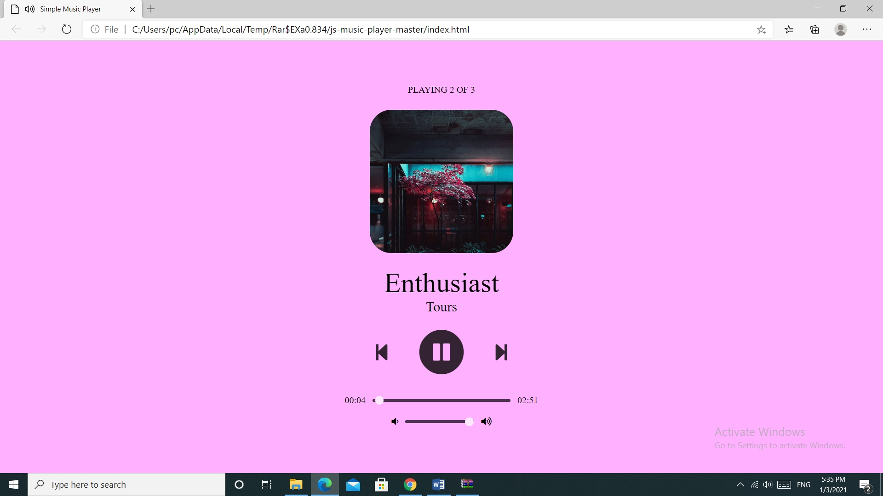
Final Demonstration
The player is now ready to be used in any browser. New tracks can be added to the tracklist to play the music of your choice.

Slide 20
THANK YOU

